Slide 1
Multi-agent pathfinding in Warehouse Automation
Phillip Wong
Supervised by:
Daniel Harabor & Pierre Le Bodic
Notes:
Morning / Afternoon ~ Name - Phillip Wong ~ Proj: MAPF ~ Along with 2, Dan, Pierre

Slide 2
Overview
Warehouse Automation
01
What is MAPF
02
Contributions
03
What is next
04

Slide 3
Motivation

Slide 4
Warehouse Automation
Kiva Systems
Peter Wurman
Automating the movement of inventory around the warehouse
Large scale - up to 1000 robots in a warehouse
Robots delivering inventory
Drive Units, Picking stations, Storage pods
Kiva Systems AKA Amazon Robotics

Slide 5
Warehouse Automation
Source: https://www.youtube.com/watch?v=8gy5tYVR-28

Slide 6
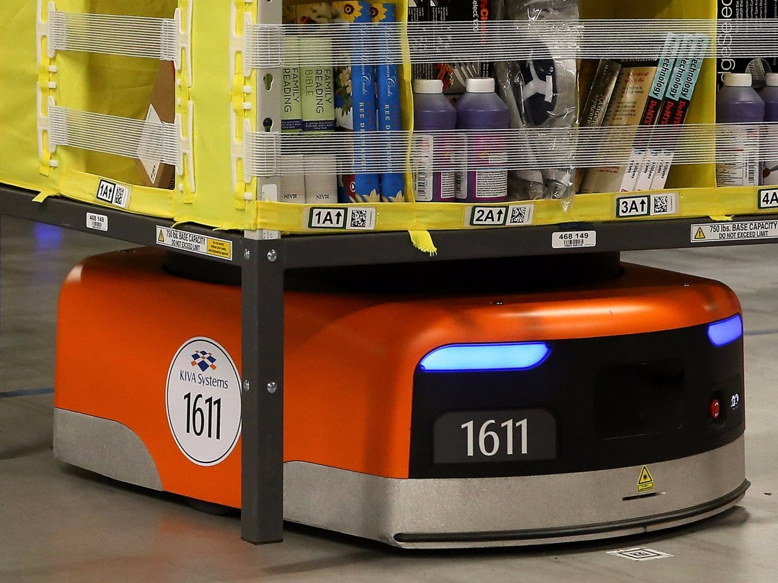
Warehouse Automation
Source: https://www.businessinsider.com.au/amazon-doubled-the-number-of-kiva-robots-2015-10?r=US&IR=T

Slide 7
Process
Receive Order
Assign Drive Unit
Unit brings order to picking station
Human worker packs the order

Slide 8
Dimensions
Map with n grids
K agents

Slide 9
Outline
Multiagent
State of the art
Our contributions

Slide 10
What is Multi-agent pathfinding?
Multiple agents moving to goal locations
For each agent find a conflict-free path to the goal
A tile can only have 1 agent at any time

Slide 11
Specifics of MAPF
Warehouse Automation
Grid-based map (no diagonal movement)
Objective Functions
Makespan
Sum of cost
Down-time
Cooperative multi-agent pathfinding

Slide 12
Solving MAPF
Optimal
Suboptimal
Guarantees
Bounded-suboptimal

Slide 13
Why optimality?
Anytime
heursistically

Slide 14
Complexity
State space grows
Number of agents (a)
Size of grid map (t)
Branching factor 5k (up / down / left / right / wait)
Number of path-conflicts (c)?
a * t * d

Slide 15
Resolving Conflicts
Search
Find a path for each agent
Conflicts
Identify conflicts between paths
Replanning
Perform search again, reduce the number of conflicts

Slide 16
Anim

Slide 17
Tree

Slide 18
Potential improvements
Search
Heuristics
Reducing search space
Conflicts
Trivial?
Replanning
Heuristics
Precomputing

Slide 19
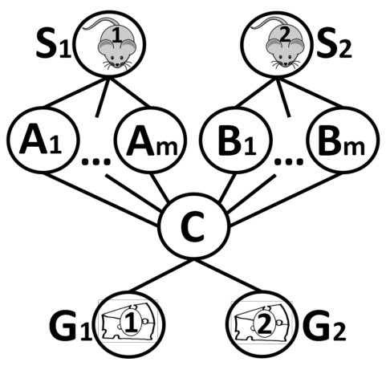
State of the art
State of the art: Conflict Based Search (CBS)
Disadvantage - branching

Slide 20
Comparison
Alternative routes
Bypass paper?
Branching

Slide 21
Contributions
Single agent pathfinding
Linear Programming
Branch and price
Jump Point Search
Compressed Path Databases

Slide 22
Integer programming

Slide 23
Expected outcomes?
Relation to warehouse

Slide 24
Current progress
Warehouse Simulation
Picking station
Drive Units
Order assignment
Single agent pathfinding (A*)
Learning Integer Programming

Slide 25
Simulation

